Slide 1
Space Invaders
A retro-style Space Invaders game where players control a spaceship to shoot down invading alien spaceships while avoiding their attacks.

Slide 2
Introduction of the Members
Radit Rifah Rahman 2524611042
Seendeed Islam 2524611042
Afrida Hossain Khan 2522096642
Course Instructor Mohammad Shifat-E-Rabbi

Slide 3
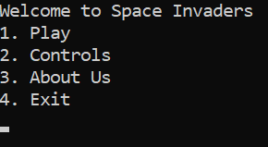
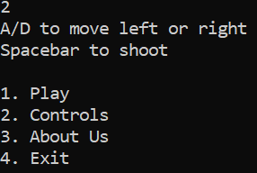
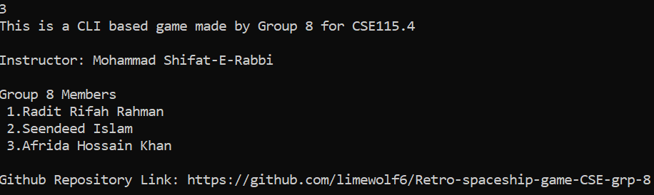
Menu Screen
Click on option 2
Click on option 3

Slide 4
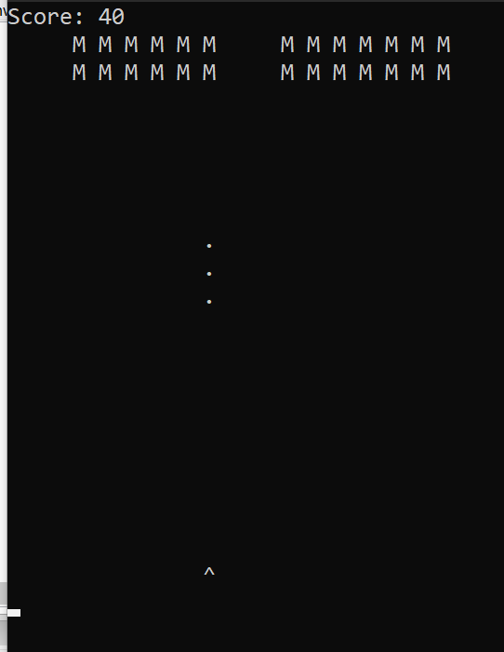

The Actual Game
Here
“M” represents the invaders
The “Dots” represent the bullets.
The “^” represent the player’s spaceship.
After game completion

Slide 5
Overcoming Hurdles
What we faced | What we changed
Explosions not disappearing after shooting invaders. Missed bullets gathering on top of screen. | Had to remove explosion and instantly make it empty. Had to improve checks for deleting bullets.

Slide 6
Future Plan
1. Aliens move and shoot lasers at the player.
2. Increased difficulty modes.
3. Real time score update on each attempt.
4. Graphical improvements made to the game.

Slide 7
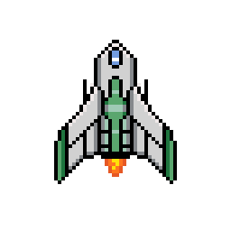
Presentation
Over !

